Slide 1

CYBER ATTACKS
Be aware, be prepared, be safe.
PRESENTED BY
DINESH JEEV
Certified: CEH | CEC | ISO27001 Lead Audit | CISA |

Slide 2

AGENDA
Recap : On Previous Session
Cyber Attacks: A Comprehensive Overview
Understanding Threats in the Digital Landscape
Introduction to Cyber Attacks
Malware Attacks
AGENDA

Slide 3

Introduction to Cyber Attacks
"In today's interconnected world, the digital realm presents both opportunities and challenges. One significant challenge is the persistent threat of cyber attacks."
Cyber attacks can disrupt, damage and even destroy businesses. The average cost of a data breach is USD 4.35 million.
This price tag includes the costs of discovering and responding to the violation, downtime and lost revenue, and the long-term reputational damage to a business and its brand.

Slide 4
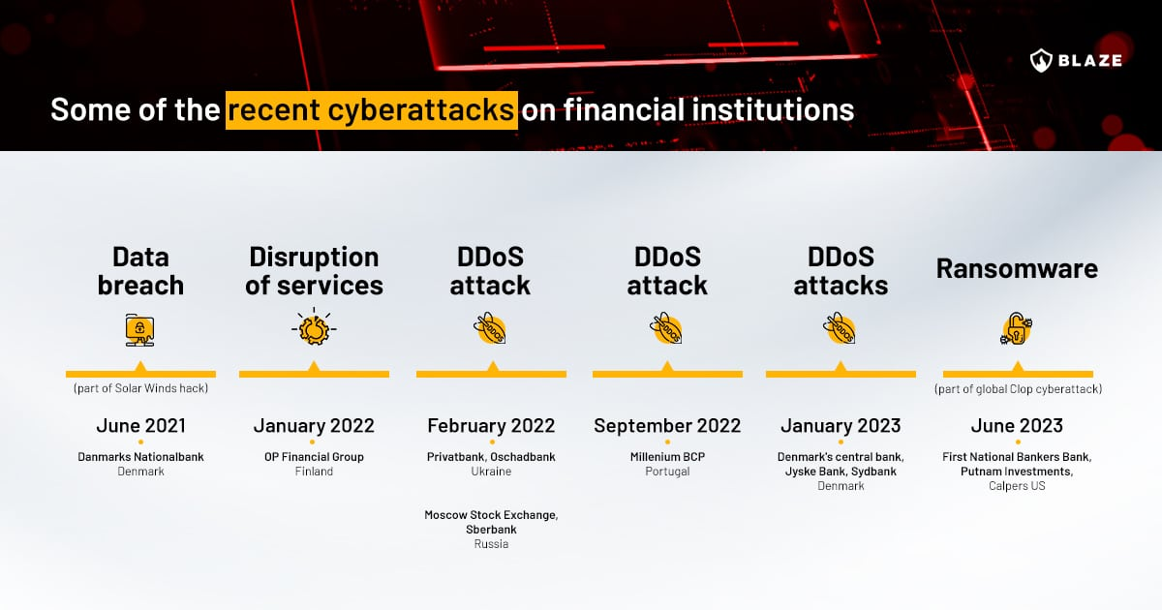

Slide 5
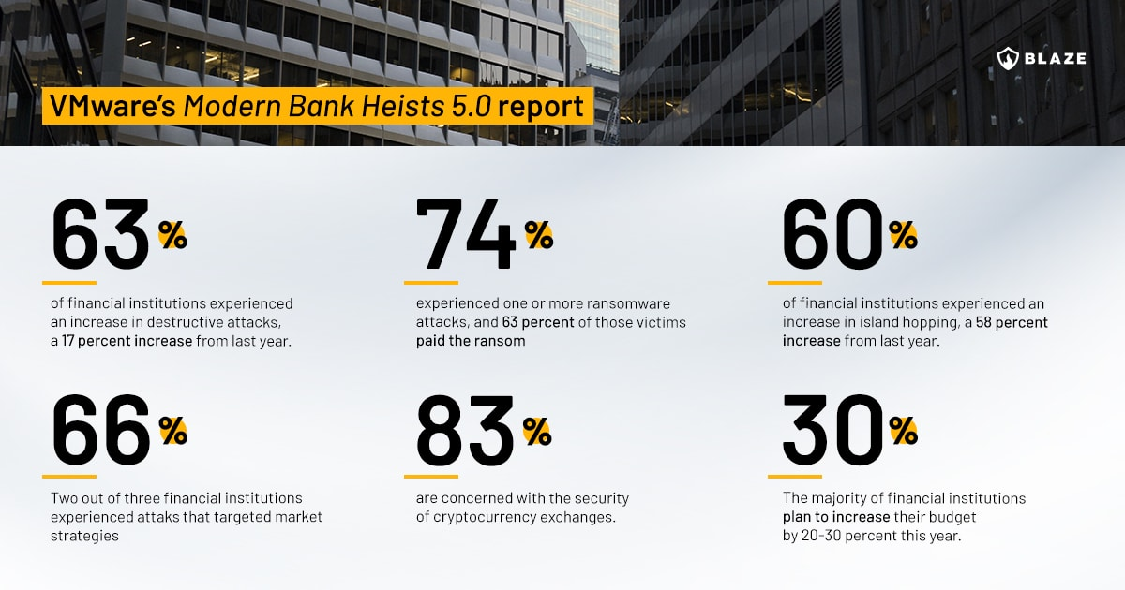

Slide 6
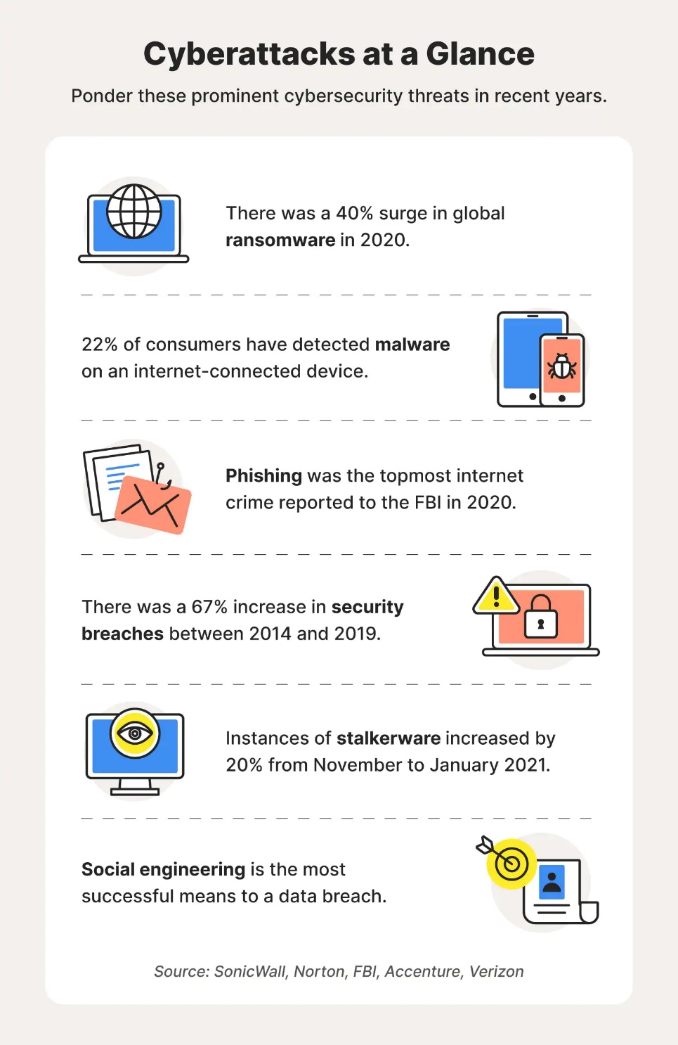
What is a cyber attack?
A cyber attack is any intentional effort to steal, expose, alter, disable, or destroy data, applications or other assets through unauthorized access to a network, computer system or digital device.
Threat actors launch cyber attacks for all sorts of reasons, from petty theft to acts of war. They use a variety of tactics, like malware attacks, social engineering scams, and password theft, to gain unauthorized access to their target systems.

Slide 7

Why do cyber attacks happen?
The motivations behind cyberattacks can vary, but there are three main categories: criminal, political, and personal.
Criminally motivated attackers seek financial gain through monetary theft, data theft, or business disruption.
Cybercriminals may hack into a bank account to steal money directly or use social engineering scams to trick people into sending money to them.
Hackers may steal data and use it to commit identity theft or sell it on the dark web or hold it for ransom.

Slide 8
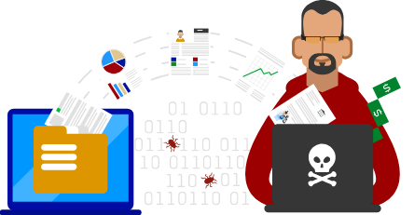
Personally motivated attackers, such as disgruntled current or former employees, primarily seek retribution for some perceived slight. They may take money, steal sensitive data, or disrupt a company's systems.
Politically motivated attackers are often associated with cyber warfare, cyber terrorism, or "hacktivism." In cyber warfare, nation-state actors often target their enemies' government agencies or critical infrastructure.
For example, since the start of the Russia-Ukraine War, both countries have experienced a rash of cyberattacks against vital institutions (link resides outside ibm.com). Activist hackers, called "hacktivists," may not cause extensive damage to their targets. Instead, they typically seek attention for their causes by making their attacks known to the public.

Slide 9
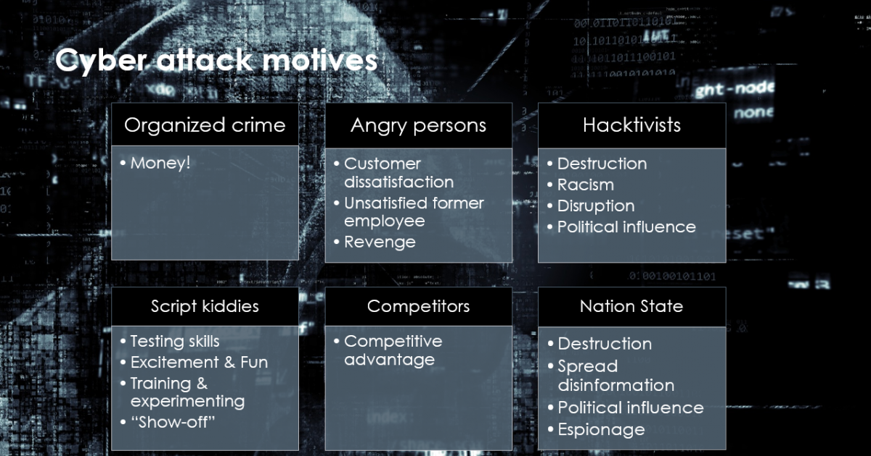

Slide 10
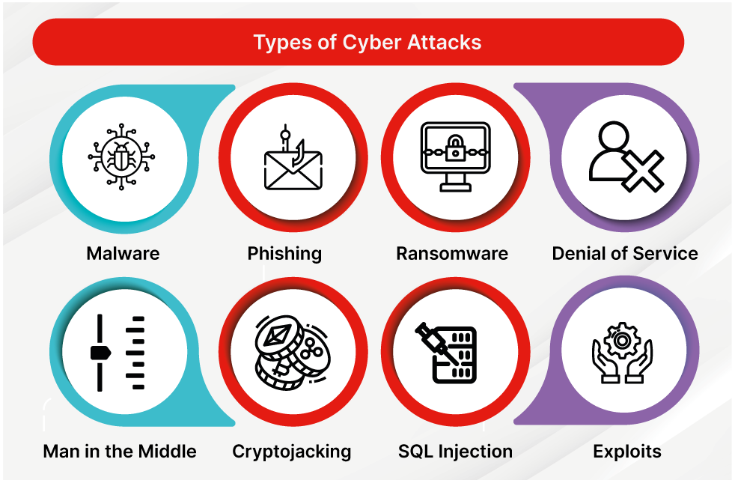

Slide 11
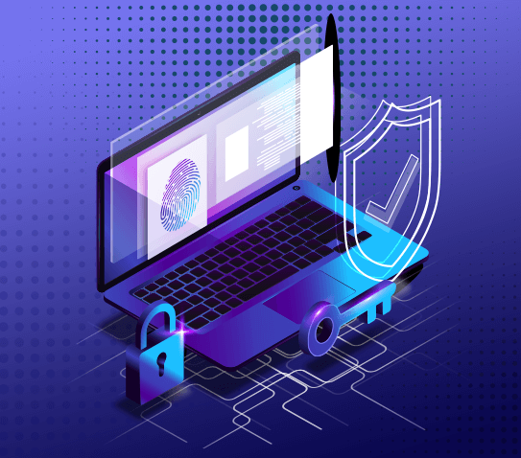
MALWARE ATTACK

Slide 12
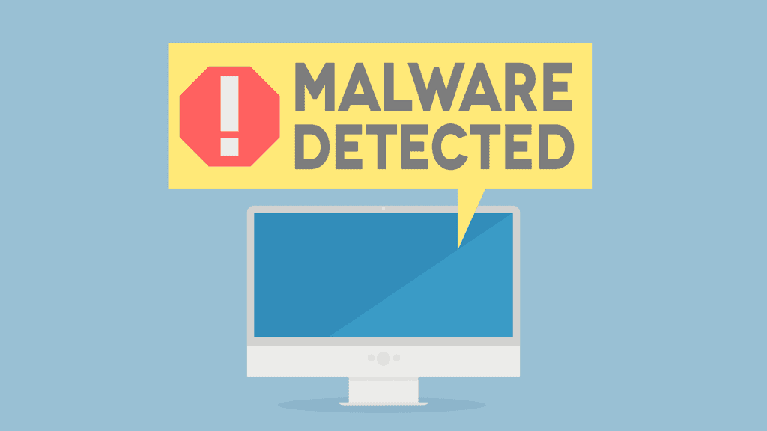
WHAT IS A MALWARE?
Malware, short for malicious software, refers to any intrusive software developed by cybercriminals (often called hackers) to steal data and damage or destroy computers and computer systems.
Malware is a pervasive and evolving threat in the digital landscape.
Examples of common malware include viruses, worms, Trojan viruses, spyware, adware, and ransomware.

Slide 13
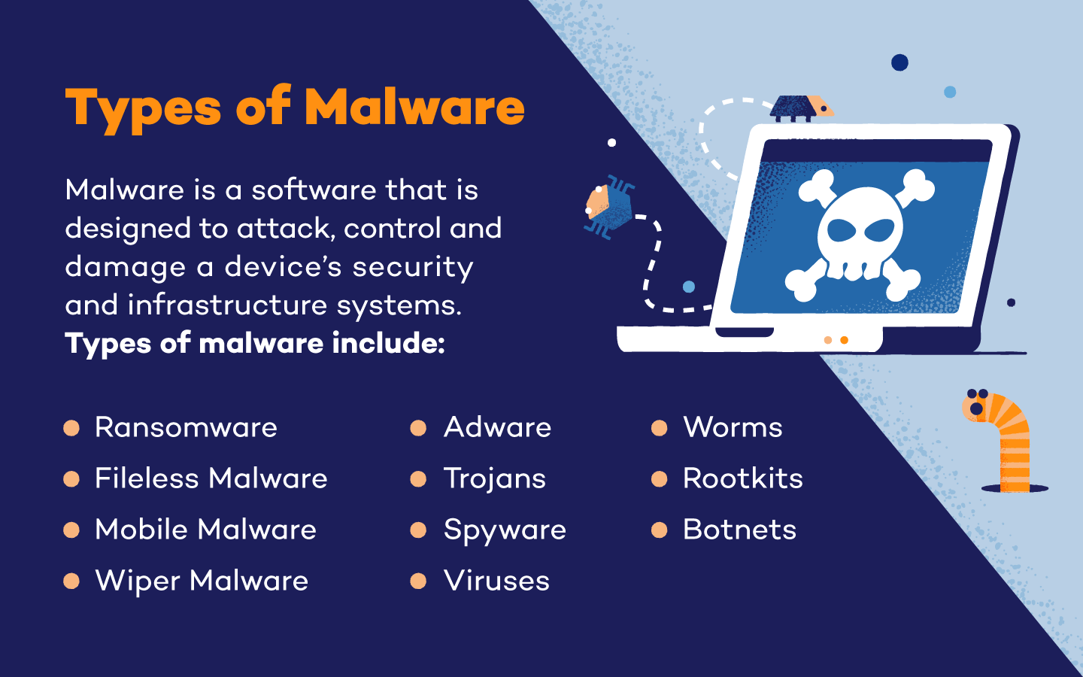

Slide 14
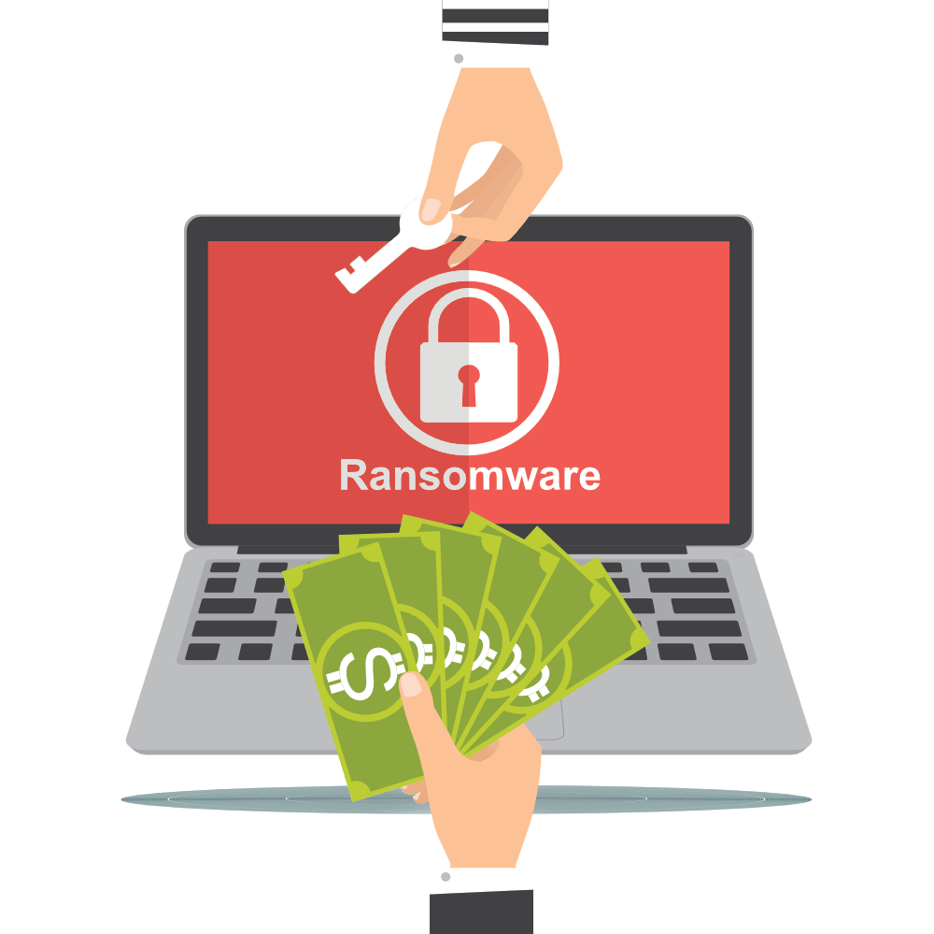
RANSOMWARE
ATTACK

Slide 15
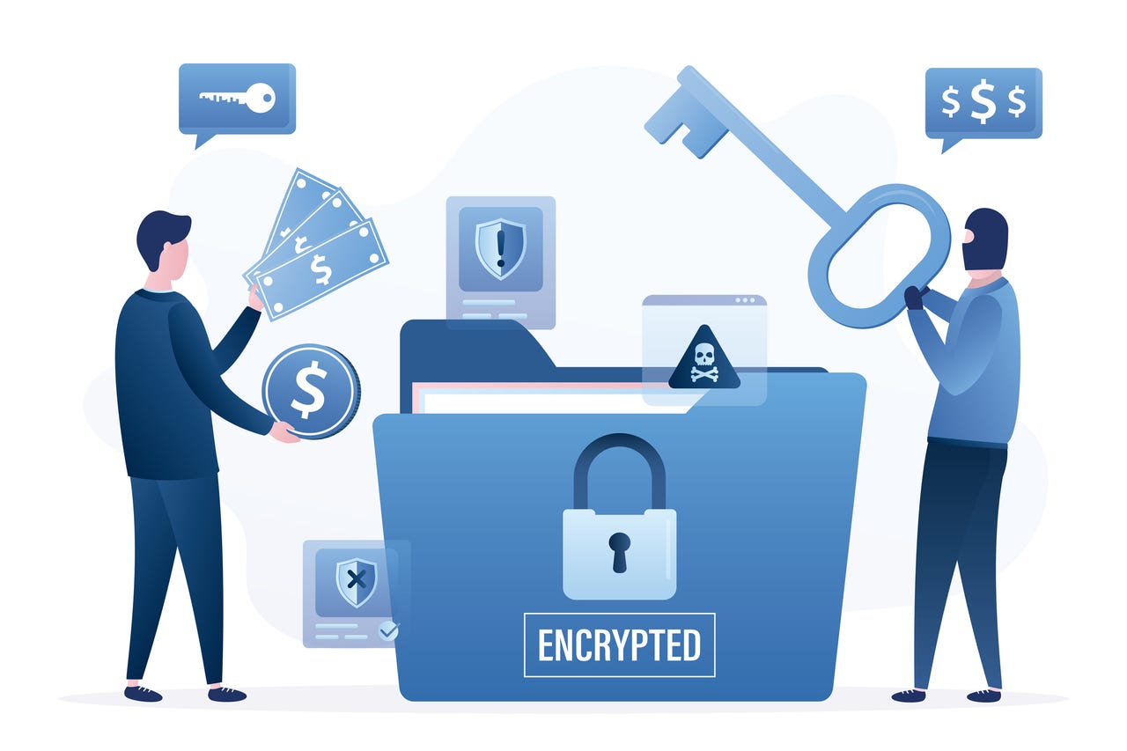
WHAT IS A RAMSOMWARE?
Ransomware is a type of malicious software designed to block access to a computer system or files until a sum of money, often in crypto-currency, is paid to the attacker.
It's a form of extortion that encrypts the victim's
files, rendering them inaccessible, and then demands
a ransom for their release.
Ransomware attacks can target individuals,
businesses, or even entire organizations, and they
can cause significant financial and operational damage.

Slide 16

Example : Wanna Cry Attack
In May 2017, the world witnessed one of the most widespread and impactful ransomware attacks in history known as the WannaCry attack.
The attack primarily targeted computers running Microsoft Windows operating systems.
WannaCry utilized a vulnerability called EternalBlue, which was initially developed by the U.S. National Security Agency (NSA) but later leaked. The malware spread rapidly through networks, exploiting this vulnerability.
Once on a system, WannaCry encrypted files, making them inaccessible to the user.

Slide 17
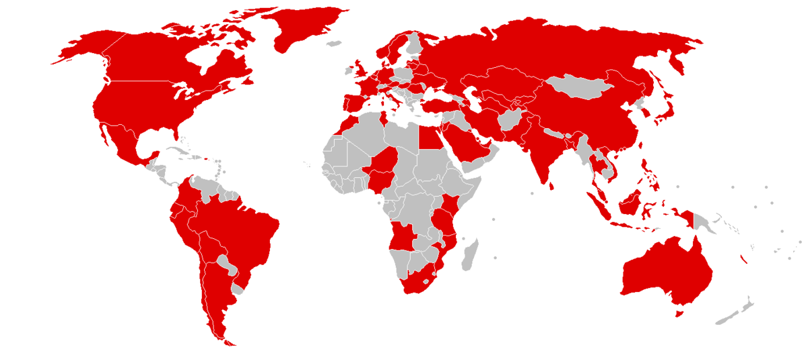
Impacts of Wanna Cry Attack
Global Reach : The attack affected hundreds of thousands of computers across more than 150 countries, including critical infrastructure such as healthcare systems, telecommunications, and transportation.
Disruption : Infected computers displayed a ransom message demanding payment in Bit-coin in exchange for the decryption key. Failure to pay within a specified time threatened permanent loss of data.
Financial Consequences: Organizations faced significant financial losses due to downtime, remediation efforts, and potential ransom payments.

Slide 18
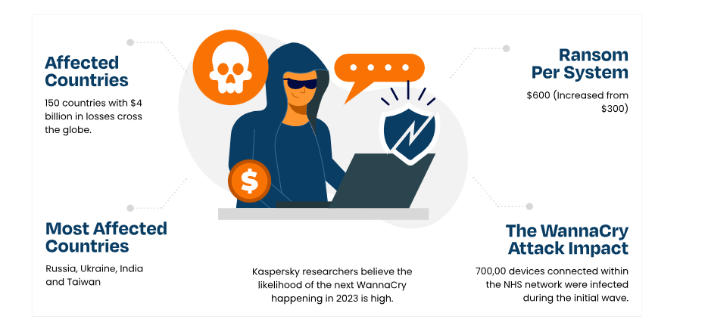

Slide 19


Slide 20

What is an Adware?
Adware, short for advertising-supported software, is a type of software that displays unwanted advertisements on a computer or mobile device.
Adware often comes bundled with free software or is
installed unknowingly when a user clicks on certain ads.
While adware is not inherently malicious, it can be
intrusive and negatively impact the user experience
by delivering pop-up ads, banners, or redirecting
browsers to advertising websites.

Slide 21

Example: Super-fish Adware
In 2015, a significant adware-related controversy emerged involving a piece of pre-installed software called Superfish on certain Lenovo laptops.
Lenovo, one of the world's leading laptop manufacturers, pre-installed Superfish on some of their laptops.
Superfish was designed to inject third-party ads into users' web browsers, including pop-ups and banners, while they browsed the internet.
What made this case particularly controversial was that Superfish used a technique known as SSL hijacking to intercept encrypted communications, potentially compromising users' security.

Slide 22
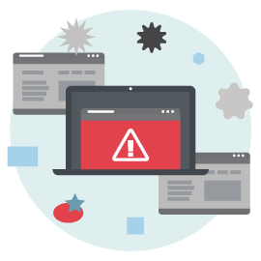
Impacts of Superfish
User Privacy Concerns: The adware raised serious privacy concerns as it had the potential to intercept sensitive information, including passwords and financial details.
Browser Vulnerabilities: The SSL hijacking technique introduced vulnerabilities in the security of encrypted connections, making users susceptible to various forms of cyber attacks.
**The incident highlighted the potential security risks associated with certain types of adware, particularly those that tamper with encrypted communications.

Slide 23


